Slide 1
Game Server with Socket Programming
- Ashikur Rahman
James Park
- Asif Talukder

Slide 2
Introduction
We programmed a game-server in java
Our game server implements java’s built-in Socket library
Server creates threads for each client it accepts and the connected clients plays against a bot which is located in the server

Slide 3
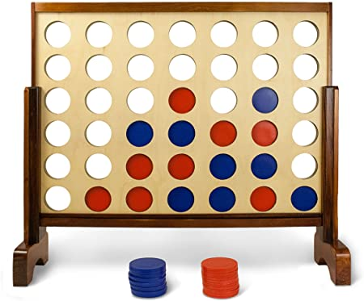
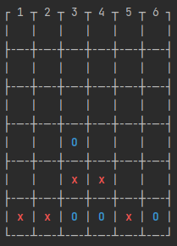
Our example game: Connect 4

Slide 4
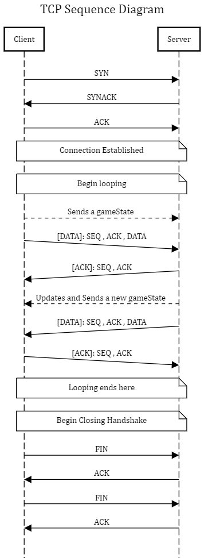
The diagram

Slide 5
Server
Maintains an instance of ServerSocket
Creates individual Socket client ; and creates new thread for each connected client.
Threads Run on a loop to handle incoming Stream of input from the clients
Branches out to different conditional situation depending on predefined input handler: such as, maps the clients names with
Edge Case: Server Crashes on CPU overload , because it creates threads for incoming clients

Slide 6
Client
Creates Socket to connect to the server
Communicates with the server sending the state back and forth , in a loop
Prompts user to make game input : in our case – making a column selection
Edge Case: Client Crashes on Server Downtime, because it tries to create connection to a certain socket, if server doesn’t respond client fails to make a connection.

Slide 7
State Management and Communication

Slide 8
Conclusion

